Slide 1

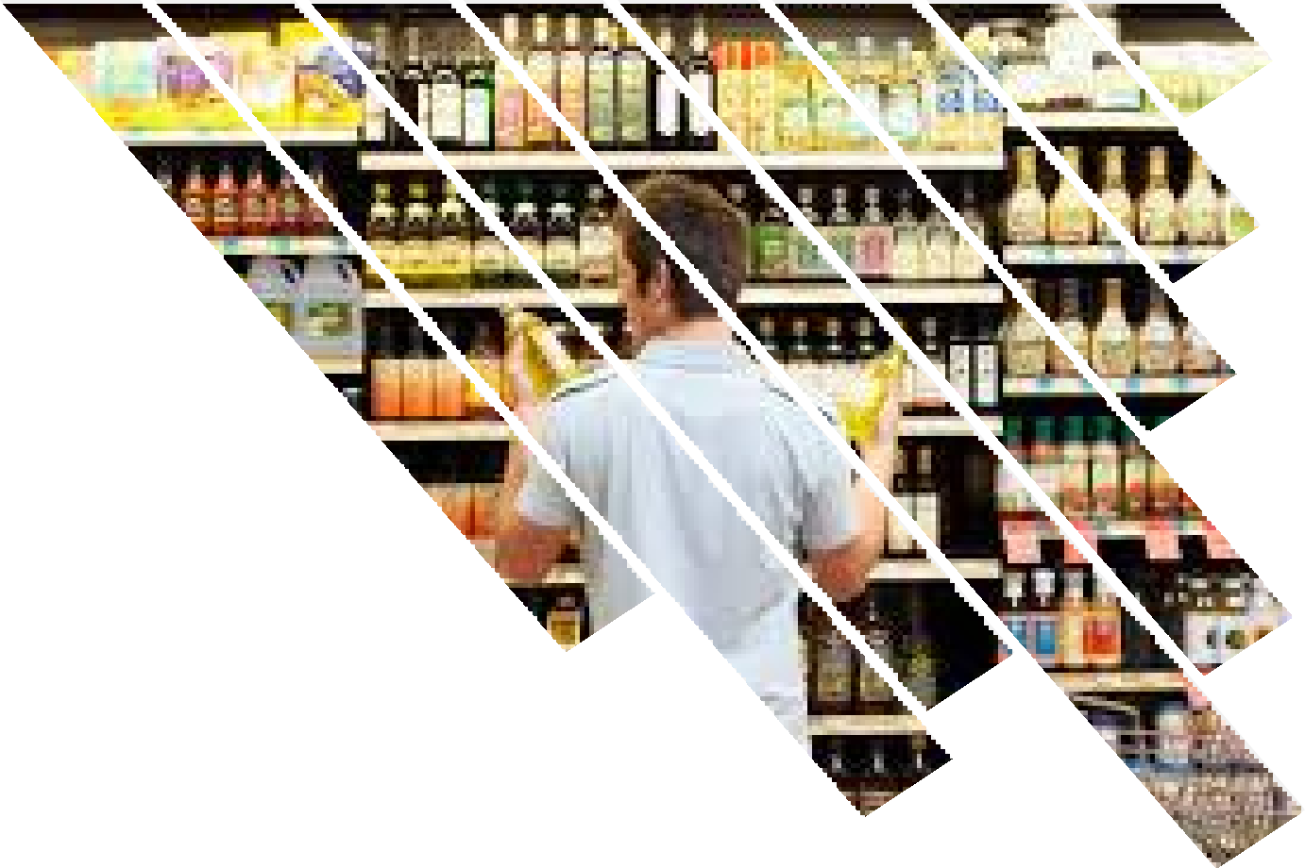
SaveSmart (Supermarket Price Comparison App)
Department of Informatics and Computer Systems
Section No. 2093
Nouf Saeed Mohammed Alqahtani | 442815940
Ruba Khaled Alasmari | 442815229
Sarah Saeed Asiri | 442809535
Supervisor: Dr. Nada Al-Asbali

Slide 2














Outlines
Project Introduction
Detailed Design
Project Background
Development and Implementation
Pro ject M anag em ent
Conclusion and Future Work
Methodology
Requirements Gathering and Analysis
System Mo d els
H ig h- Level System D esig n
2

Slide 3
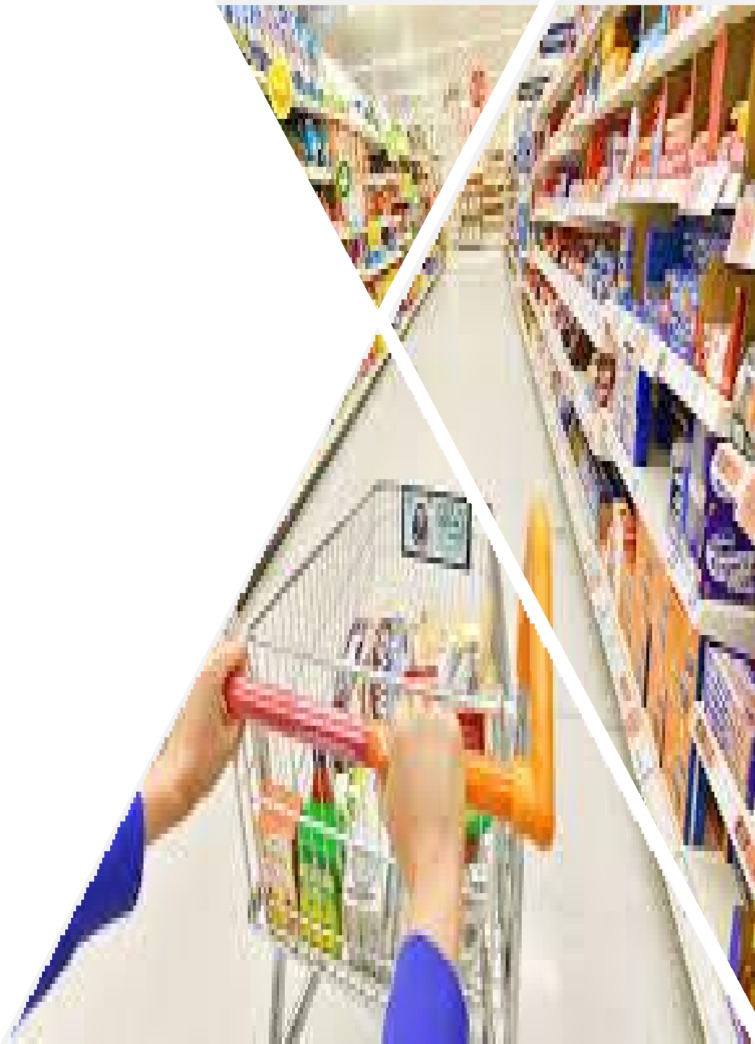
Introduction
Goal: develop a mobile that enables users to make informed, cost-effective shopping decisions by comparing real-time prices of grocery items across various supermarkets in their area.
Motivation: In an era of rising living costs, many families and individuals struggle to manage their household expenses effectively.
Significance: Addresses a widespread need for price transparency and economic shopping. By facilitating smarter purchasing choices, the app helps users save money and time.

Slide 4

Project Background
Context:
Technological advancements have transformed many aspects of daily life, yet price comparison for groceries remains largely manual or fragmented.
Problem Domain:
The core problem lies in the lack of a unified platform that provides real-time price comparisons across different supermarkets. Consumers often make purchasing decisions based on habit or proximity rather than price competitiveness, leading to unnecessary spending.
4

Slide 5


Challenges:
Data Availability and Accuracy: Accessing up-to-date and accurate pricing information from multiple supermarkets is a major technical and logistical hurdle. Many stores do not provide open APIs, requiring alternative methods like web scraping or partnerships.
Scalability: As user demand and supermarket data grow, ensuring fast response times and system stability becomes essential. The app must handle concurrent users, large datasets, and frequent updates without performance degradation
.
Competition: Several price comparison platforms exist, though most focus on electronics or online shopping. Differentiating SaveSmart through features like personalized alerts, historical price tracking, and location-based searches is key to user adoption.
User Trust and Engagement: Ensuring that the data provided is reliable and the interface is intuitive will be crucial for building user trust and retaining engagement over time.

Slide 6

Project Management
Methodology
A recommendation Engine will be implemented: a product suggestion system based on user behavior. The user's purchase history will be analyzed and personalized, intelligent product suggestions will be
provided based on the type of product and the time of purchase, based on their past purchase history.
1
2
Time-based patterns: Here, recommendations are made based on the length of time between consecutive purchases.
Content-based filtering: For recommendations based on product type

Slide 7

Project Timeline
Research & Planning:
Identify target users and their shopping behaviors
Study existing competitors and their limitations Finalize the project scope, goals, and deliverables
Requirements & Concept Design:
Design key use cases and user journeys
Define the system architecture and choose the technology stack
Prototyping & Documentation:
Develop a non-functional prototype or mockup Feature plan and architecture diagram
7

Slide 8
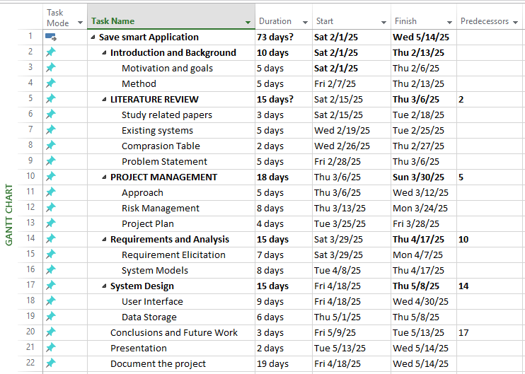
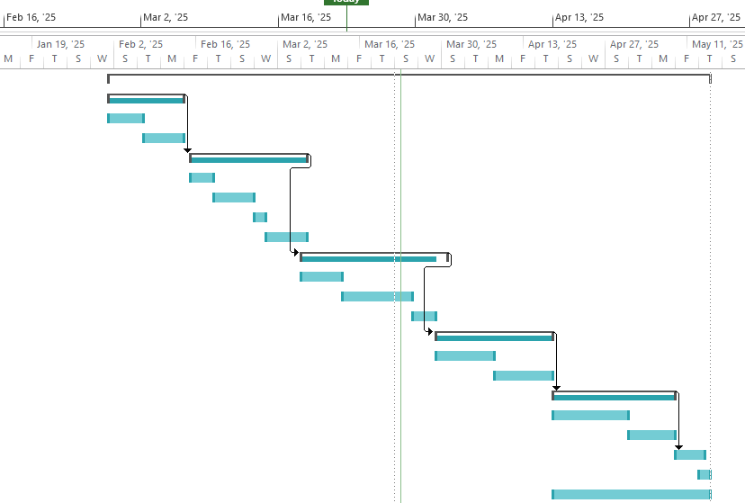
Gantt chart
8

Slide 9


Tools and software requirements
1
Flutter (Dart) for app development: Flutter is easier and faster
than React Native for front-end development.
2
Laravel (PHP) for back-end development: A simple and powerful
framework for creating RESTful APIs.
3
MySQL for storing product and price data: It's more common
and easier to manage database
4
Python for the recommendations section and AI Section.

Slide 10
Methodology
A recommendation Engine will be implemented: a product suggestion system based on user behavior. The user's purchase history will be analyzed and personalized, intelligent product suggestions will be provided based on the type of product and the time of purchase, based on their past purchase history.
2
1
Content-based filtering: For recommendations based on product type
Time-based patterns: Here, recommendations are made based on the length of time between consecutive purchases.

Slide 11
Requirements Gathering and Analysis
Requirement | Type | Description | Priority
User Account Creation & Login | Functional | Users should be able to register, log in, and manage their profiles. | High
Product Search | Functional | Users should be able to search for grocery items by name or category. | High
Price Comparison Display | Functional | Display real-time or periodically updated prices of products across supermarkets. | High

Slide 12
Requirements Gathering and Analysis
Location-Based Search | Functional | Use GPS or user input to show prices relevant to the user's area. | High
Shopping List Creation | Functional | Users can create and manage shopping lists within the app. | Medium
Price Alert Notifications | Functional | Notify users when selected items drop in price or go on promotion. | Medium
Historical Price Data | Functional | Display price trends and history for selected products. | Low
Data Accuracy and Freshness | Non-Functional | Ensure product prices are accurate and updated regularly (e.g., daily). | High
System Usability | Non-Functional | The interface should be user- friendly, intuitive, and accessible. | High
Performance and Scalability | Non-Functional | App should load quickly and scale efficiently with increased users or data. | Medium
Security and Privacy | Non-Functional | User data must be stored securely with encryption and privacy compliance. | High
Cross-Platform Accessibility | Non-Functional | App should work on both mobile (iOS, Android) and web browsers. | Medium
Maintainability and Extensibility | Non-Functional | Codebase and design should allow easy updates and feature expansions. | Medium

Slide 13




Existing systems
1
Fusto g :O ne of the most pop ular app lications in the King dom of Saudi
A rabia, it allows users to compare prices of products and food comm odities between different supermarkets in all reg io ns of the King dom
2
Tabby Shop:Tabby Shop is a digital shopping assistant that showcases over 500,000 products from thousands of brands, with advanced shopping tools like smart search, wishlists, and special offers alerts.
3
Pricena:This app allows users to compare prices in Saud i Arabia, UA E, Eg ypt, Q ata r and Kuwait.
Karma Application:It is an integrated platform that allows the user to download the application or add an extintion to allow tracking the price history of electronic products.
4
13

Slide 14
Comparison Table
Feature | Fustog | Tabby Shop | Pricena | Karma | SaveSmart
Price Comparison | Yes | Yes | Yes | Yes | Yes
Product Category | Supermarke ts Products | Clothes, Electronics | Electronics, Home Supplies | Electronics, Home Supplies | Supermarkets Products
Smart Recommendation System | NO | Yes | NO | NO | Yes
Smart Purchase Alerts | Yes | Yes | Yes | Yes | Yes
Price Statistics | Yes | Yes | Yes | Yes | Yes
Smart Shopping Lists Offer the cheapest product | NO | Yes | NO | NO | Yes
Includes organized product categories | Yes | Yes | Yes | Yes | Yes
Available in The kingdom of Saudi Arabia | Yes | NO | Yes | NO | Yes
14

Slide 15

UML Diagrams
1
Use case Diagram
2
Sequence Diagrams
3
Activity Diagrams
4
Class Diagram
15

Slide 16
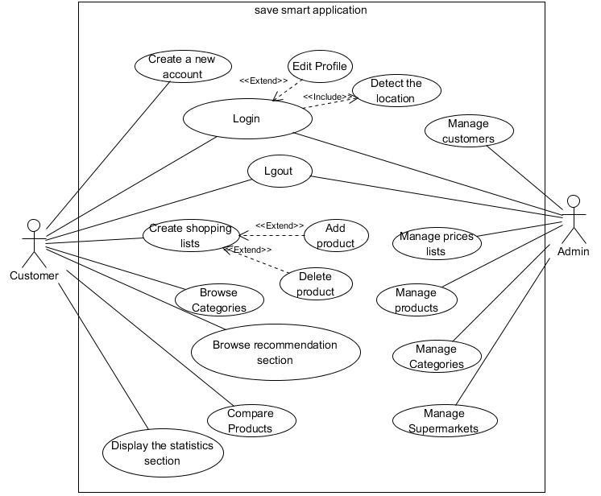
1
Use case Diagram

Slide 17
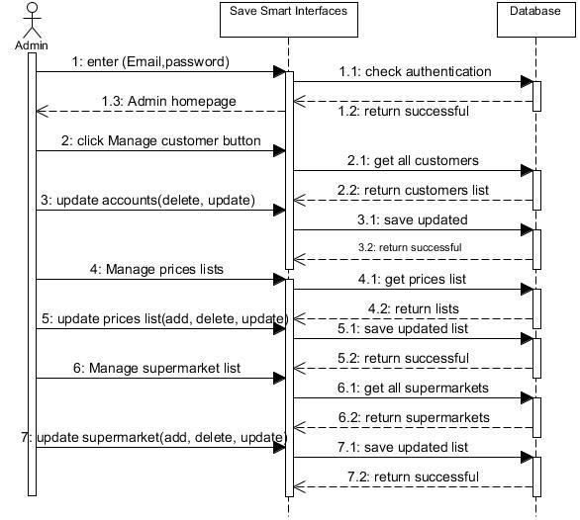
2
Sequences Diagram(Admin)

Slide 18
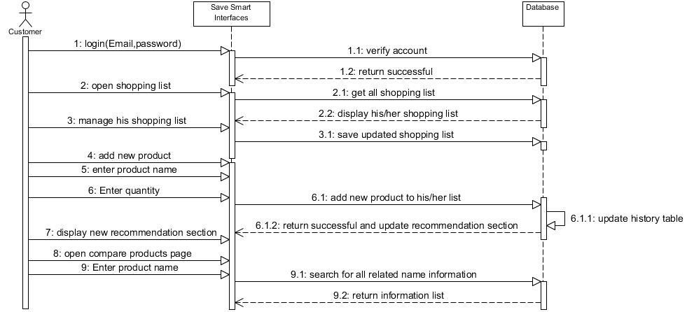
2
Sequences Diagram(Customers)

Slide 19
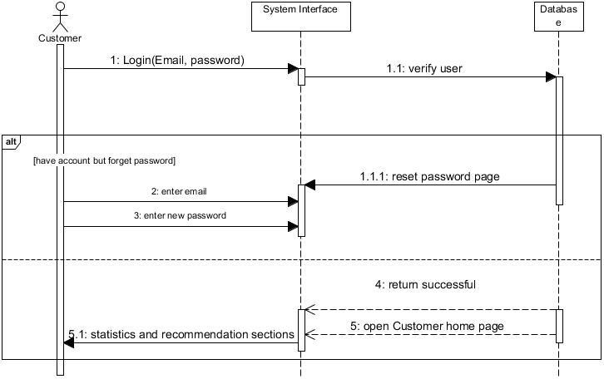
2
Sequences Diagram(Customers)

Slide 20
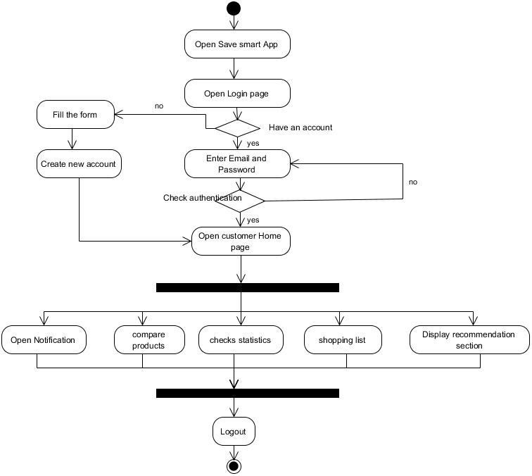
3
Activity Diagram

Slide 21
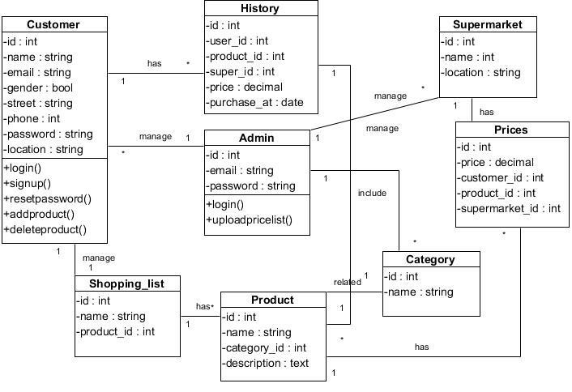
4
Class Diagram

Slide 22
SYSTEM Design
1
DATABASE Design
2
INTERFACES
22

Slide 23
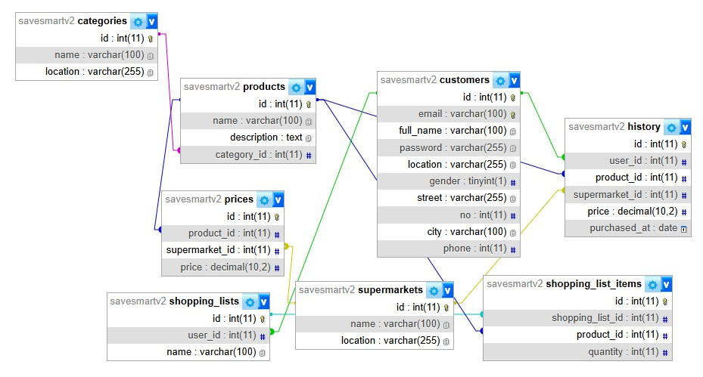
1
DATABASE

Slide 24
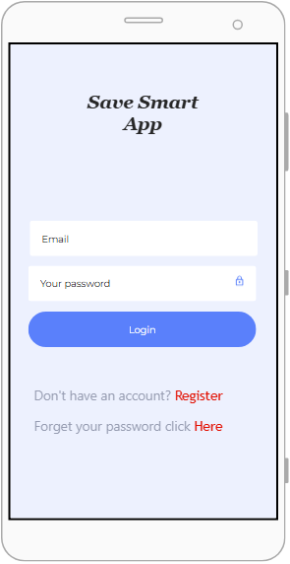
2
INTERFACE(Login Interface)

Slide 25
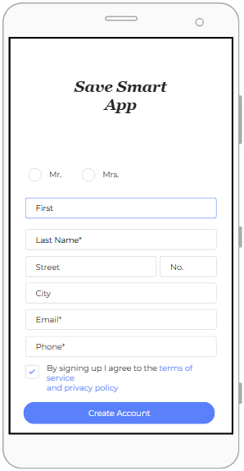
2
INTERFACE(Registration Interface)

Slide 26
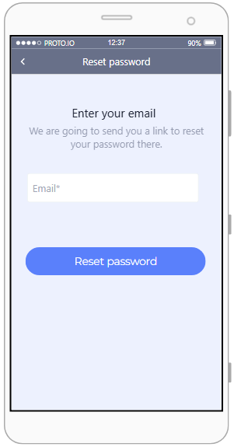
2
INTERFACE(Reset Password)

Slide 27
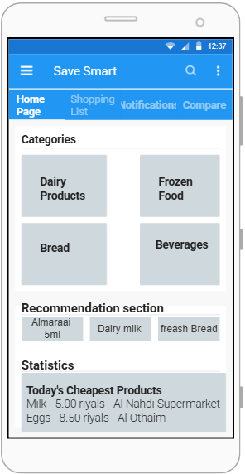
2
INTERFACE(Customer homepage)

Slide 28
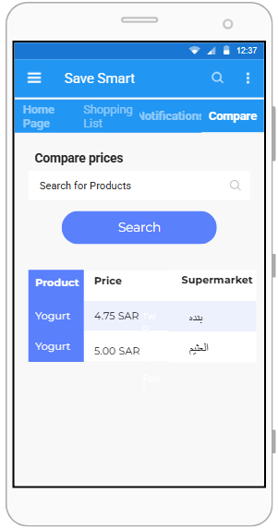
2
INTERFACE(Compare page)

Slide 29
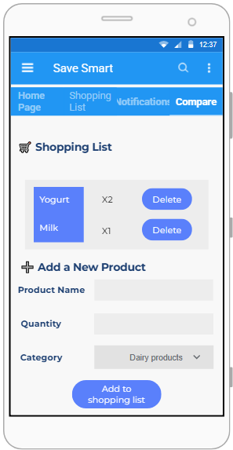
2
INTERFACE(Shopping list page)

Slide 30

Future Work
1
Develop front-end section with Flutter
2
Develop the backend and building an API with Laravel to connect to the database and for the intelligence department.
3
Integration between all departments will be ensured.
4
The project will be tested (unit testing, usability testing, black box testing, and white box testing).

Slide 31







Future Work for SaveSmart
Working on developing a mechanism for manually updating prices in real time, by integrating the app with other smart tools.
Exporting the app to iPhone and Android devices and releasing it.
Adding new and diverse services to further enrich
the project.
Adding a mechanism that allows customers to rate recommendations and improve future suggestions.

Slide 32
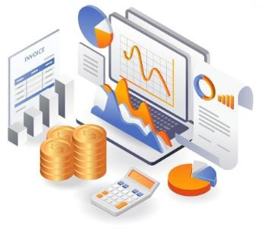
Conclusion
The SaveSmart project presents a forward-thinking solution to a common consumer challenge: the need for smarter, more economical shopping. Although this phase of the project is centered on research, design, and feasibility analysis, it lays a strong foundation for future development. With a clear understanding of user needs, technical requirements, and potential challenges, SaveSmart has the potential to evolve into a valuable tool for cost-conscious shoppers. This project not only addresses a relevant problem in today’s economic climate but also demonstrates how technology can be used meaningfully to enhance everyday life.

Slide 33
References
[1] | M. Samadi, “Waterative Model: an Integration of the Waterfall and Iterative Software Development Paradigms,” 2019.
[2] | J. Thomas, “Amazon and Automated Recommendations.,” Critical Cultural Communication, 295..
[3] | I. M. Gironacci, “Literature review of recommendation systems.,” Transdisciplinary perspectives on risk management and cyber intelligence. 119-129, 2021.
[4] | “myfitnesspa,” 2 3 2025. [Online]. Available: https://www.myfitnesspal.com/.
[5] | “Udemy,” 2 3 2025. [Online]. Available: https://play.google.com/store/apps/details?id=com.udemy.android.
[6] | G. G. V. A. M. W. &. C. S. P. Parker, “Platform revolution: How networked markets are transforming the economy and how to make them work for you.,” WW Norton & Company., 2016.
[7] | “Fustog,” [Online]. Available: https://play.google.com/store/apps/details?id=app.fustog&hl=ar. [Accessed 1 3 2025].
[8] | “Tabby,” [Online]. Available: https://tabby.ai/en-AE/tabby-shop. [Accessed 2 3 2025].
[9] | “pricena aplication,” [Online]. Available: https://play.google.com/store/apps/details?id=com.naddad.pricena. [Accessed 1 3 2025].
[10] | “Karma Application,” [Online]. Available: https://www.karmanow.com/?ad_id=732361694813&adgroupid=173406847086&device=c&gad_source=1&gclid=EAIaIQobChMI8Y295bDriwMVN1 CRBR0GOhxbEAAYASAAEgIti_D_BwE&keyword=price+history+tracker&utm_campaign=22207411410&utm_source=GooglePPC. [Accessed 1 3 2025].
[11] | Q. L. J. &. J. Y. Zhang, “Artificial intelligence in recommender systems.,” Complex & Intelligent Systems, 7(1), 439-457, 2021.

Slide 34
THANK YOU
Any Question?

