Slide 1
Enhancing Project Budget Prediction Using AI:
A Case Study Analysis
Name | ID
Joud Nasser Al-mshary | 442803378
Ghadah Khalid Asiri | 441806793
Waad Abdullah Alshahrani | 442807834
Ghadah Mohammed Al talhan | 442807823
Manal Ghashem Alshahrani | 442807813

Slide 2
Introduction
In this presentation, we will introduce the project titled "Project budget prediction using AI." The project focuses on leveraging artificial intelligence to predict project budgets accurately. Our main objective is to analyze the user-interface design of the existing solution for project budget prediction using AI. Through this analysis, we aim to assess the effectiveness and usability of the interface. We will also explore potential improvements and innovative ideas to enhance the user experience. By evaluating the user-interface design, we can identify any drawbacks or limitations of the current solution and propose creative solutions to make it more effective and user-friendly.
2

Slide 3
Literature Review and Background Research
3

Slide 4
Brief research on the background:
The document provides insights into the history of budget forecasting and financial planning, highlighting the importance of accurate financial planning for businesses. It emphasizes the significance of good financial management in achieving economic growth and success for institutions. Budget forecasting is crucial for setting future budgets, tracking cost expenditures, attracting investor interest, and ensuring financial stability. The document also discusses the challenges individuals face in managing project budgets efficiently and the need for modern solutions to address these issues.
4

Slide 5
In comparing the existing solutions like Microsoft Project, QuickBooks, and PlanGrid with the proposed AI-driven budget forecasting application, several key differences emerge:
Primavera P6
Microsoft Project
A project management software widely used in industries like construction and engineering, focusing on project planning, scheduling, and control.
Known for its user-friendly interface and tools for organizing project schedules, tasks, and resources effectively.
QuickBooks
PlanGrid
Popular accounting software designed to help businesses manage financial transactions, track expenses, and perform accounting tasks efficiently.
An innovative construction management platform that enhances collaboration among construction teams by providing access to project information on mobile devices.
5

Slide 6
Drawbacks and Limitations of Existing Solutions
While the existing solutions mentioned (Primavera P6, Microsoft Project, QuickBooks, PlanGrid) offer valuable features for project budgeting, they also have certain limitations and disadvantages that should be considered. Here are some drawbacks commonly associated with these solutions:
6

Slide 7
Complexity
Cost
Limited Collaboration
Primavera P6 and Microsoft Project are powerful but complex project management tools, requiring substantial training to navigate effectively.
Primavera P6 and similar solutions can be pricey, especially for small to medium-sized businesses, with initial costs, licensing fees, and ongoing maintenance expenses posing financial challenges.
Existing solutions may lack robust real-time collaboration features and smooth sharing of project budget information with stakeholders, hampering effective communication and collaboration within project teams.
Industry-Specific Focus
Integration Challenges
Limited Customization
PlanGrid and similar solutions, designed for construction, might not sufficiently address budgeting needs across industries, limiting their versatility and potentially necessitating further customization.
Integrating existing solutions with other software, like accounting or ERP systems, can be complex, leading to data inconsistencies and workflow disruptions.
Users might encounter constraints when customizing existing solutions to meet their project budgeting needs, limiting adaptability to unique project scenarios.
7

Slide 8
Innovative and Creative Solutions
To enhance the existing case study and make it more effective and user-friendly, we propose the following innovative solutions and potential improvements:
8

Slide 9
Intuitive User Interface
Smart Budgeting Suggestions
Real-time Collaboration
Design an intuitive interface with clear icons, organized menus, and easy-to-use controls to simplify navigation and reduce the learning curve, ensuring an enhanced user experience.
Integrate AI algorithms for intelligent budgeting suggestions, leveraging historical data and industry benchmarks to aid decision-making and enhance budget prediction accuracy.
Enable real-time collaboration for project team members to access and update budget information simultaneously. This fosters seamless communication, teamwork, and ensures everyone has access to the latest budget data.
Customizable Templates
Predictive Analytics
Integration with Financial Systems
Provide customizable budget templates tailored to different project types, sizes, and industries, offering a convenient starting point while allowing for specific adaptations.
Implement predictive analytics to forecast budget risks, identify cost-saving opportunities, and offer proactive recommendations, empowering data-driven decision-making for project managers and optimizing budget utilization.
Ensure seamless integration with financial systems like accounting software or ERP systems to automate data synchronization and streamline reporting, improving budget tracking efficiency and eliminating manual tasks.
9

Slide 10
Execution or Results
Design a prototype or user interface for the proposed solution.
In the execution phase, we have designed a prototype user interface for the improved budget prediction system, incorporating the key features and functionalities discussed earlier. Here is an overview of the design and the showcased elements:
10

Slide 11
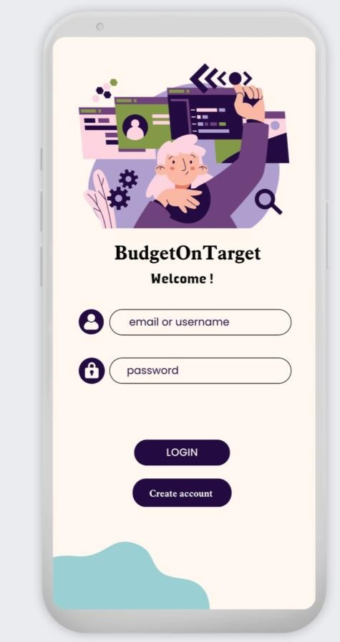
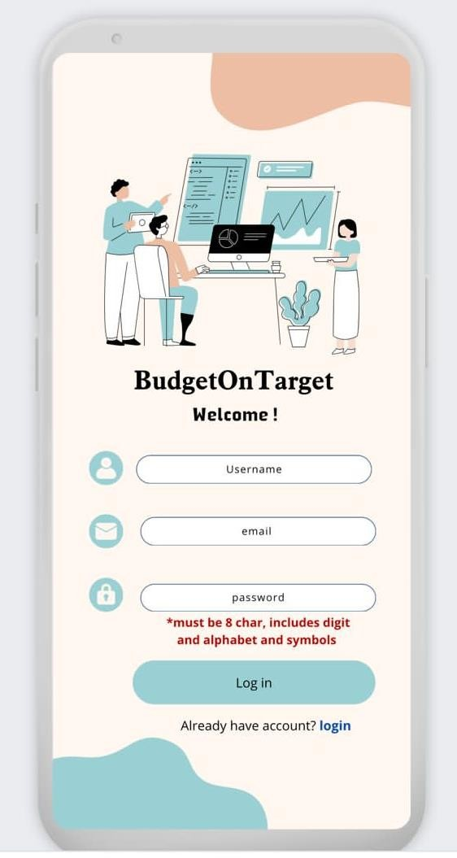
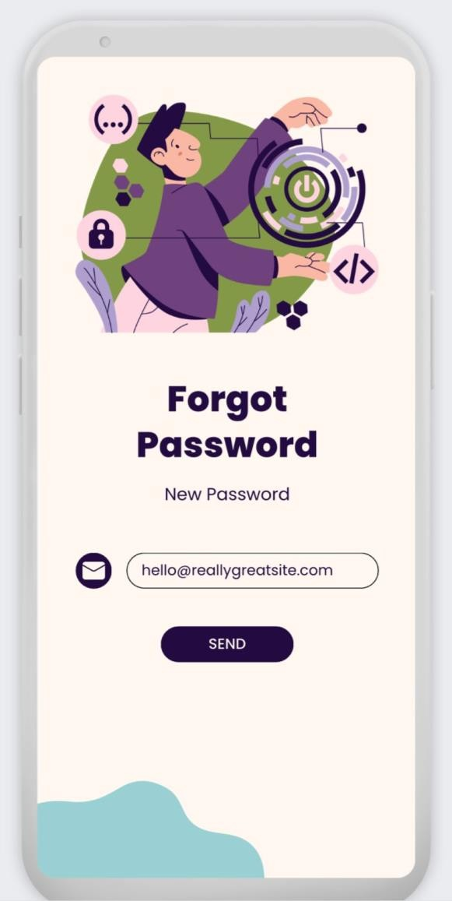
user interface
register interface
forgot password interface
10
login interface

Slide 12
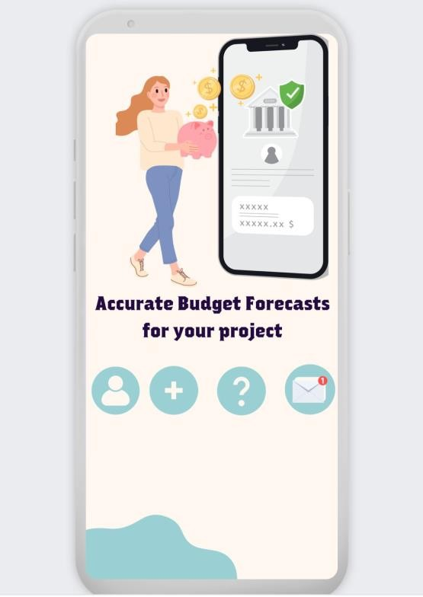
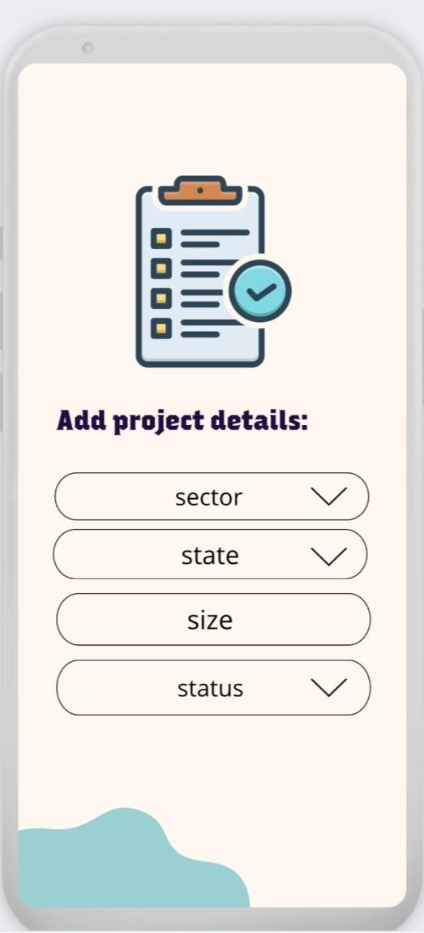
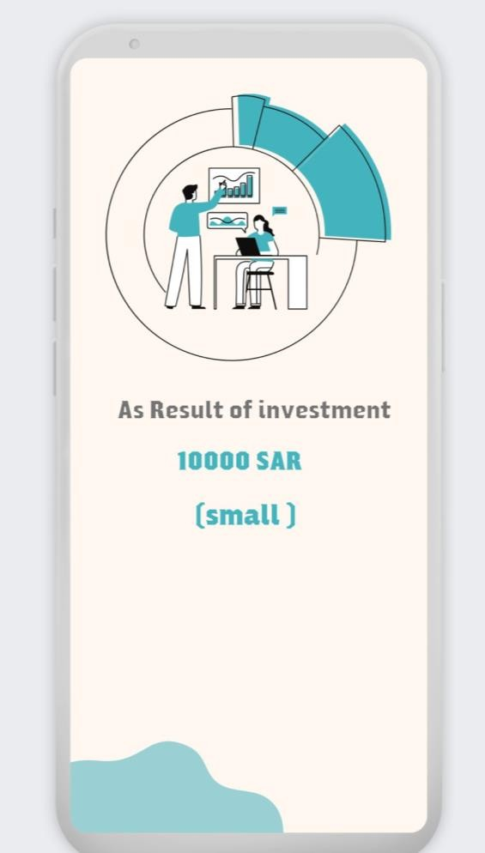
user interface
home interface
project details interface
result interface
11

Slide 13
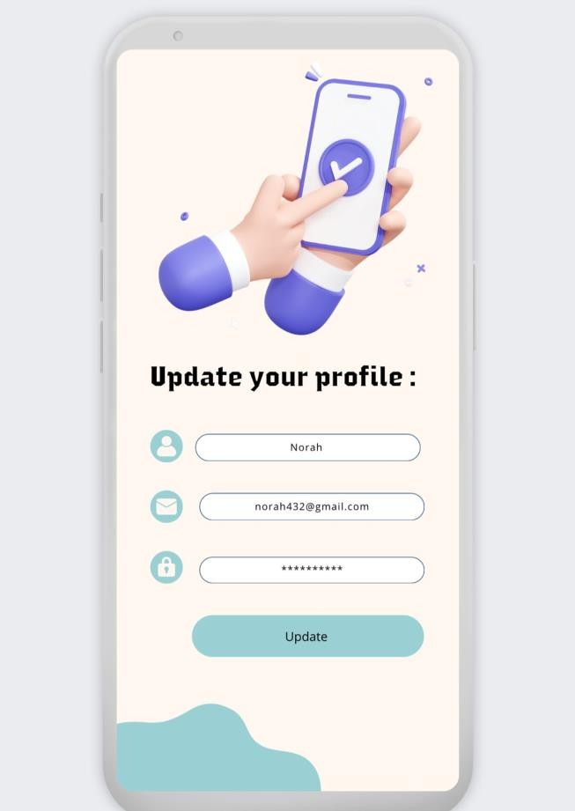
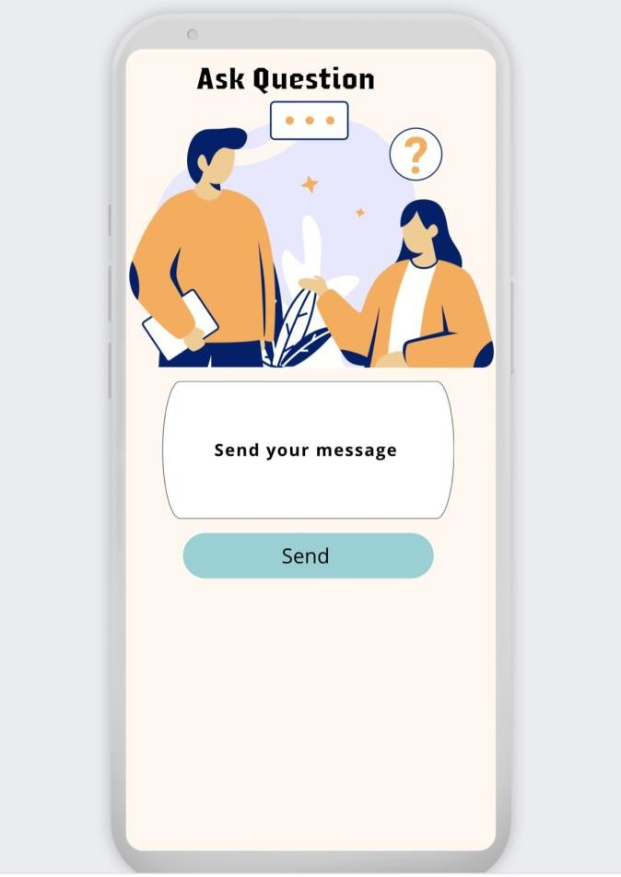
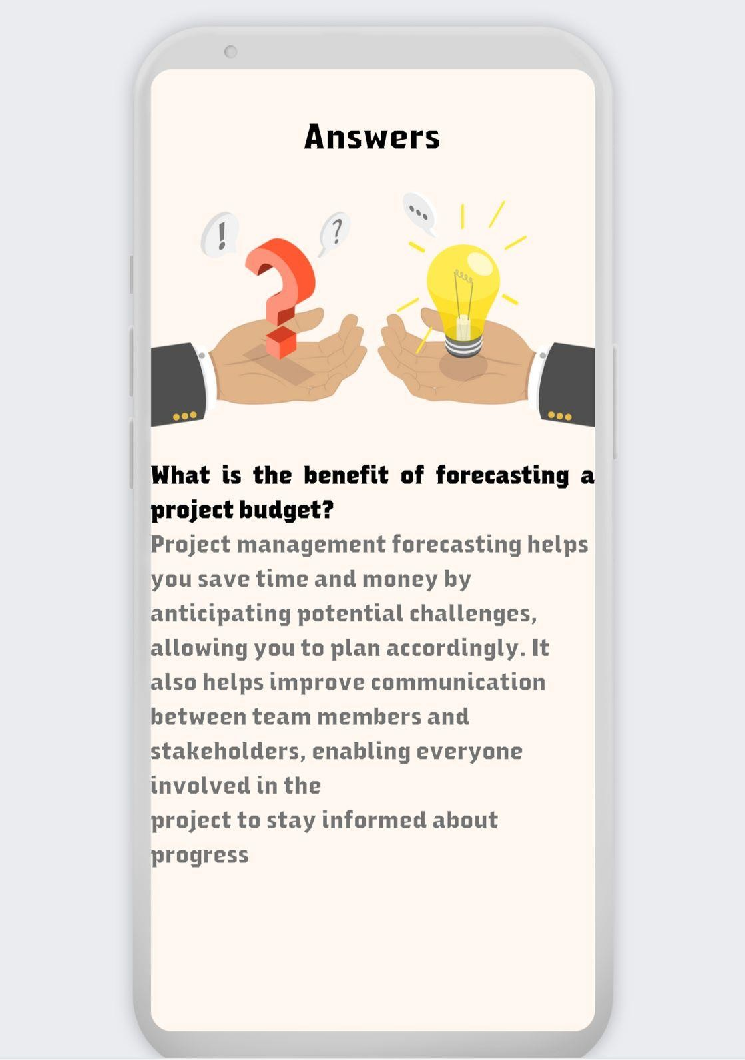
user interface
update profile interface
answer interface
ask question interface
11

Slide 14
User Interface Design:
Smart Budgeting Suggestions:
Clean and modern interface with intuitive navigation.
Well-organized menus and clear icons for easy access to different sections.
Responsive design for seamless user experience across devices.
Intelligent budgeting suggestions based on historical data, industry benchmarks, and project-specific parameters.
Predictive algorithms that analyze data and provide recommendations for optimizing budget allocation.
Real-time Collaboration:
Customizable Templates:
Real-time collaboration features enabling multiple project team members to access and update budget information simultaneously.
Comments and discussion threads for effective communication and collaboration.
Pre-defined budget templates that can be easily customized to align with different project types, sizes, and industries.
Flexibility to add or modify budget categories and line items as per project requirements.
11

Slide 15
Predictive Analytics:
Integration with Financial Systems:
Advanced predictive analytics capabilities for forecasting budget risks and identifying cost-saving opportunities.
Proactive recommendations for mitigating budget overruns and optimizing resource allocation.
Seamless integration with accounting software or ERP systems for automated data synchronization.
Real-time financial reporting and visibility into budget performance.
Mobile Accessibility:
Through this prototype, we aim to provide a user-friendly and effective budget prediction system that empowers project teams with accurate insights, collaborative features, and advanced analytics. The showcased design elements and functionalities address the identified limitations of existing solutions and offer innovative solutions to enhance the project budgeting process.
Mobile application or responsive web interface for accessing the budget prediction system on-the-go.
Ability to view, update, and monitor budgets from anywhere, ensuring productivity and responsiveness.
12

Slide 16
CONCLUSION
13

Slide 17
This presentation highlighted project budget prediction using AI and analyzed existing solution UI design. We identified drawbacks and proposed intuitive UI, smart budgeting, real-time collaboration, customizable templates, predictive analytics, financial system integration, and mobile access.
Insights include UI importance, AI's value, collaboration, and predictive analytics' significance. Benefits encompass streamlined processes, error reduction, better decisions, enhanced collaboration, resource optimization, and successful project outcomes.
By addressing limitations and adding features, the enhanced system offers a comprehensive solution, equipping teams with tools to optimize financial performance, ensure cost control, and drive project success.
14

Slide 18
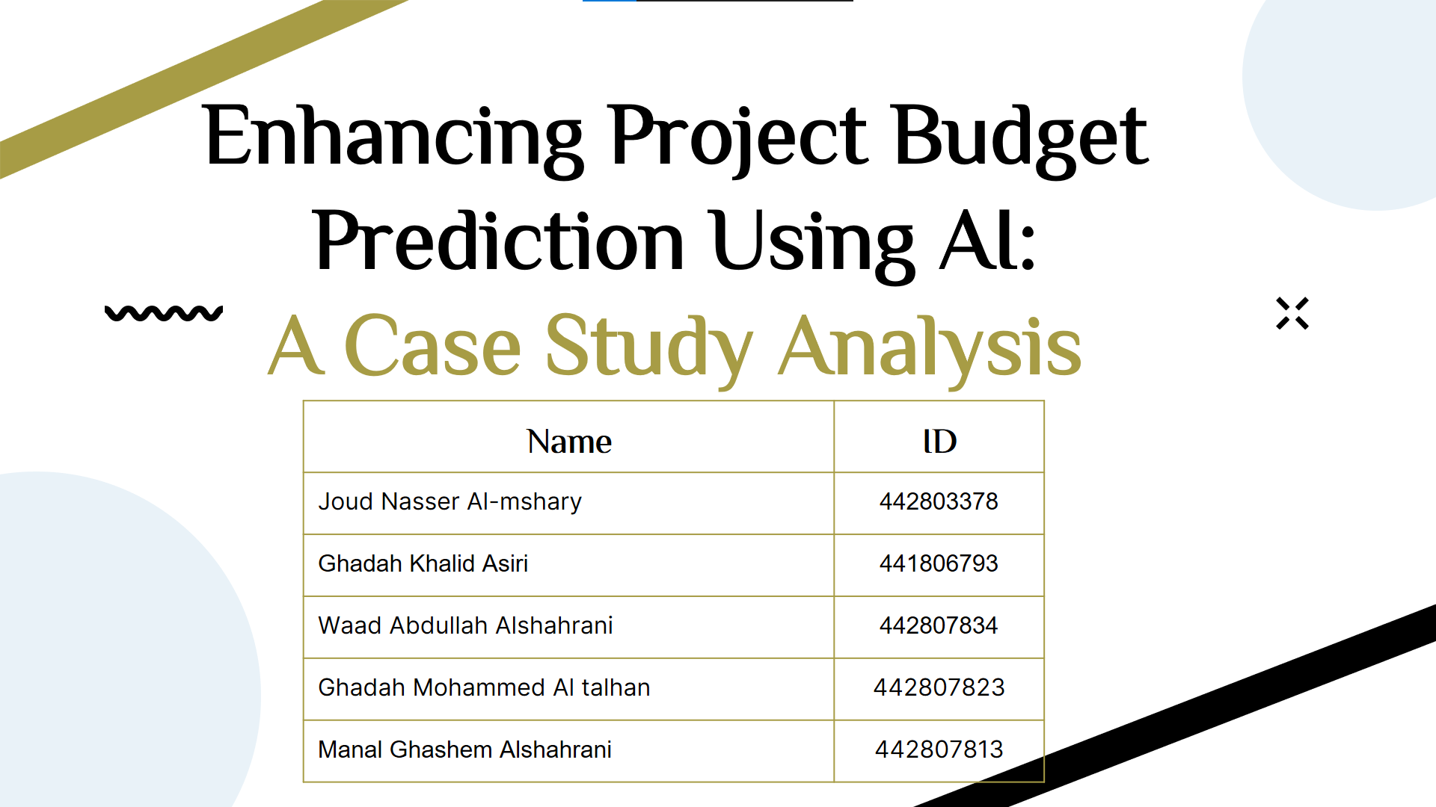
THANKS!
15

